Slide 1
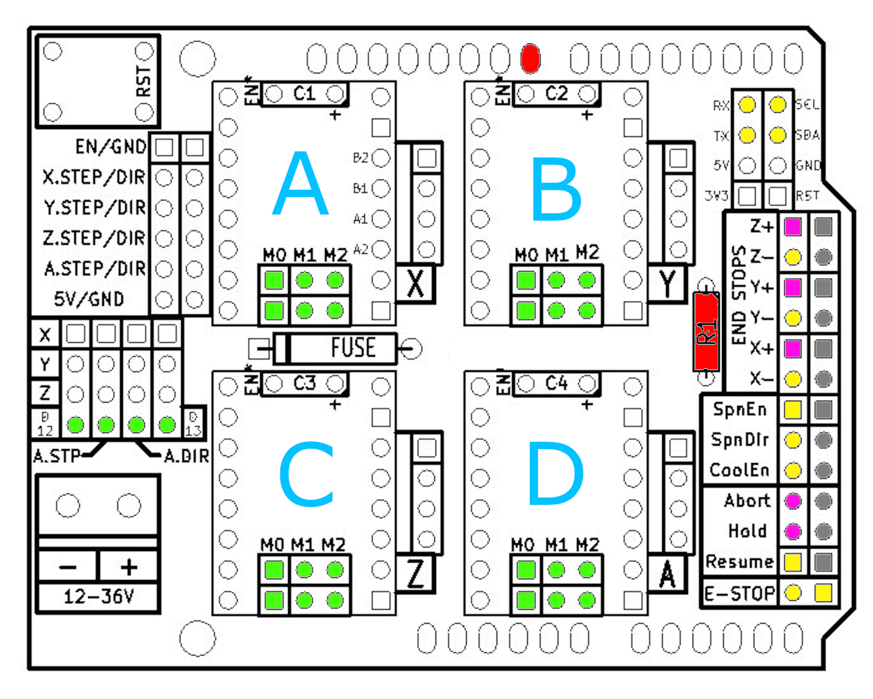
Beeper
Servo 2
Servo 1
(Step D)
(Dir C)
(Endstop C)
(Blue LED)
Ctrl1
(Endstop D)
External Reset
Insert
Jumper
Hardware
Modification
Fixed Function
Flexible
Function
Stepper
Indentification

